Slide 1
ANALYSIS OF AIR POLLUTION IN BARCELONA
PRANAV BHATT – PES1201800764
ANUSHKA DWIVEDI – PES1201800162
DHRUV SHETTY – PES1201800083
SHREYA SHUKLA – PES1201800124

Slide 2
PROPERTIES ON THE DATASET
Air Quality
Latitude
Longitude
Ozone Quality, Hour and Value
Nitrogen Dioxide Hour, Quality and Value
PM10(Suspended Particles) Hour, Quality and Value
Generated
Date/Time

Slide 3
PACKAGES USED
tidyr
dplyr
Zoo
ggpubr
plotly
corrplot

Slide 4
OZONE POLLUTION
Good Ozone: Occurs naturally in the upper atmosphere of the Earth and is also known as stratospheric ozone. Here, it forms protective shields which protect us from sun's harmful UV radiations. Due to various manmade chemicals it is partially destroyed and causes hole in the ozone.
Bad Ozone: It is ground level ozone which is not directly emitted into the air and is known as Tropospheric ozone. It is generated by the chemical reactions of nitrogen oxides and volatile organic compounds (VOC). This happens when the pollutants are emitted by cars, power plants, industrial boilers; chemical plants etc. and these chemicals react in the presence of sunlight. Do you know that at ground level it is harmful air pollutant because it effects in people and the environment and also is the main ingredient in smog?
In urban areas on hot sunny days ozone reaches to unhealthy levels and can reach high levels during cold weather. Now, you may be thinking that in rural areas this ozone reaches or not? Yes at rural areas also ground level ozone transported by the wind and can experience high ozone levels.

Slide 5
N02 POLLUTION
Nitrogen dioxide is an irritant gas, which at high concentrations causes inflammation of the airways.
When nitrogen is released during fuel combustion it combines with oxygen atoms to create nitric oxide (NO). This further combines with oxygen to create nitrogen dioxide (NO2). Nitric oxide is not considered to be hazardous to health at typical ambient concentrations, but nitrogen dioxide can be. Nitrogen dioxide and nitric oxide are referred to together as oxides of nitrogen (NOx).
NOx gases react to form smog and acid rain as well as being central to the formation of fine particles (PM) and ground level ozone, both of which are associated with adverse health effects.

Slide 6
PM10 POLLUTION
Particle pollution, also called particulate matter or PM, is a mixture of solids and liquid droplets floating in the air. Some particles are released directly from a specific source, while others form in complicated chemical reactions in the atmosphere.
Particles come in a wide range of sizes. Particles less than or equal to 10 micrometers in diameter are so small that they can get into the lungs, potentially causing serious health problems. Ten micrometers is less than the width of a single human hair.
Coarse dust particles (PM₁₀) are 2.5 to 10 micrometers in diameter. Sources include crushing or grinding operations and dust stirred up by vehicles on roads.
Fine particles (PM_{2.5}) are 2.5 micrometers in diameter or smaller, and can only be seen with an electron microscope. Fine particles are produced from all types of combustion, including motor vehicles, power plants, residential wood burning, forest fires, agricultural burning, and some industrial processes

Slide 7
CODE

Slide 8
DATA CLEANING:

Slide 9
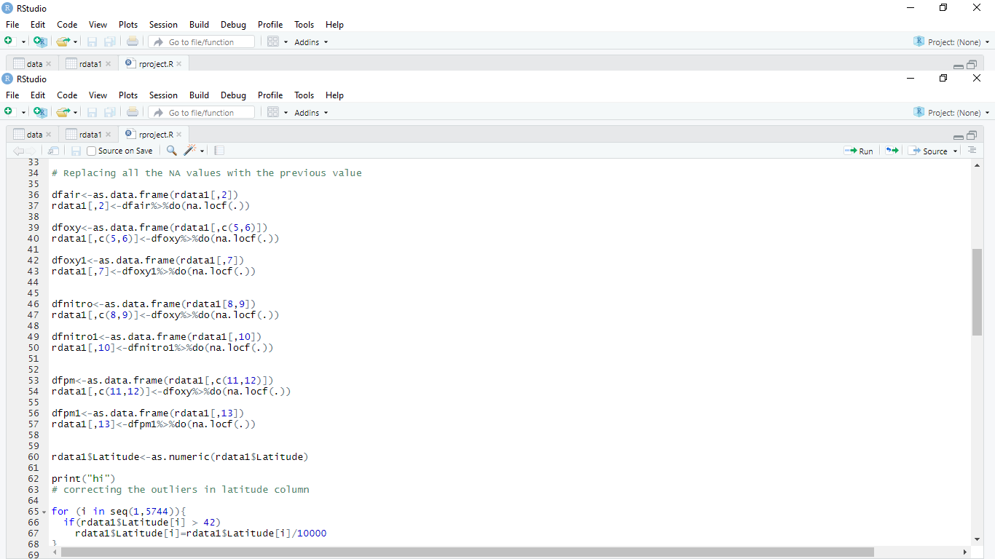

Slide 11
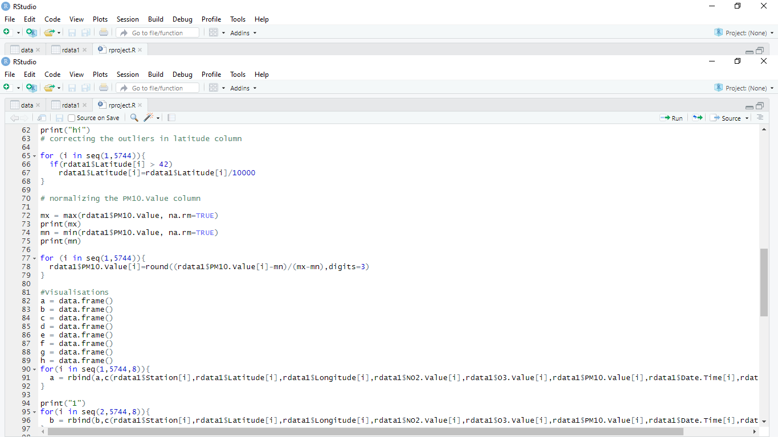

Slide 12
VISUALISATIONS:

Slide 13
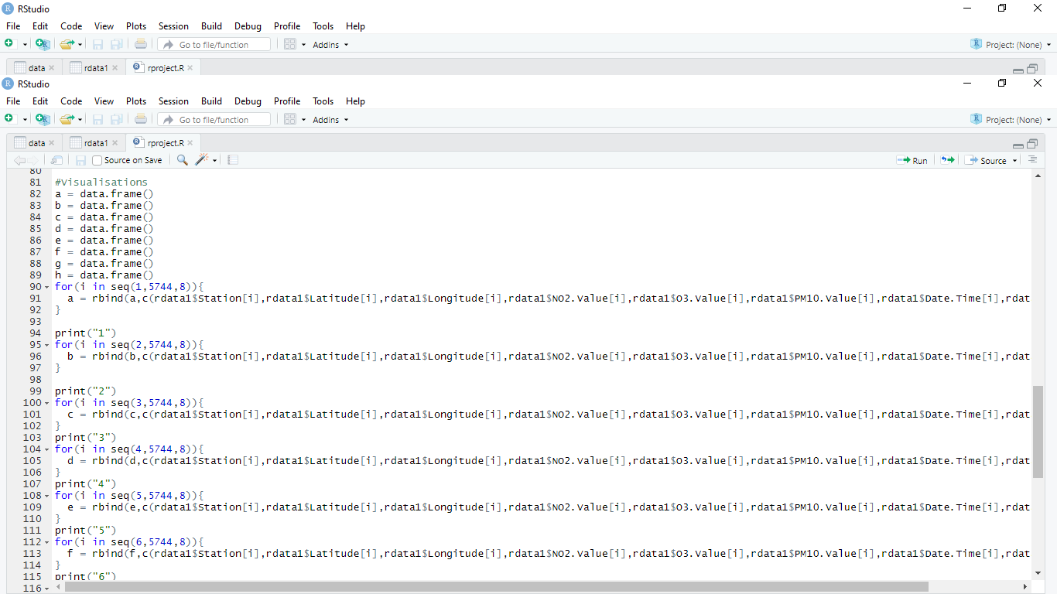

Slide 14
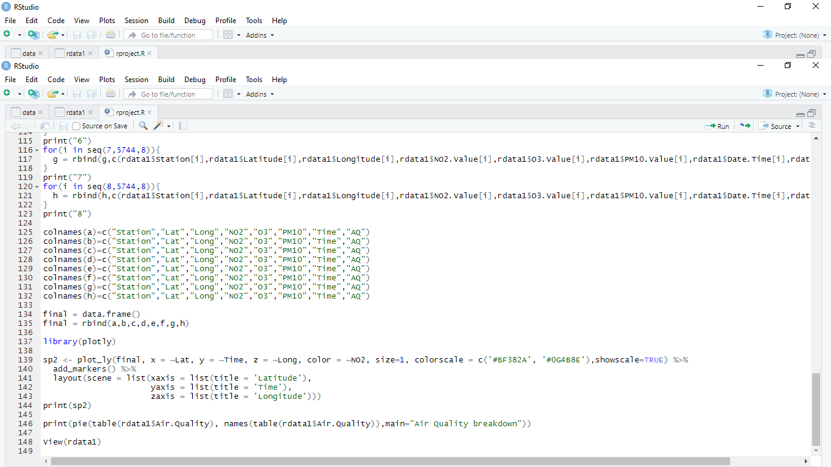

Slide 15
HYPOTHESIS TSETING:

Slide 16
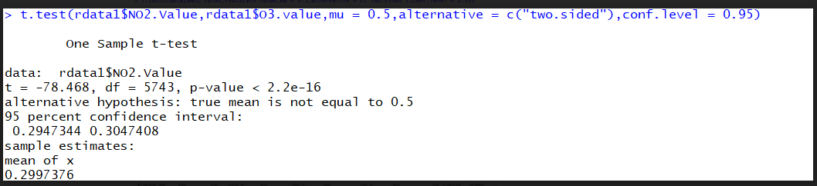

Slide 17
VISUALISATIONS

Slide 18
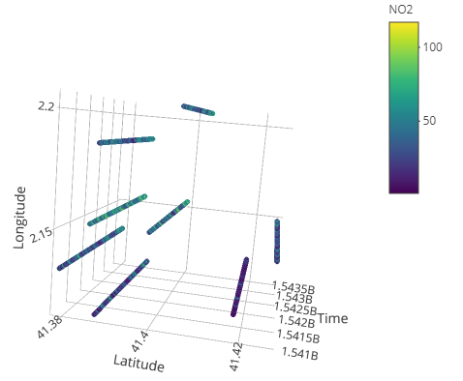
A LOCATION DEPENDENT STUDY OF CHANGE OF NO2 LEVELS OVER A THREE MONTH PERIOD

Slide 19
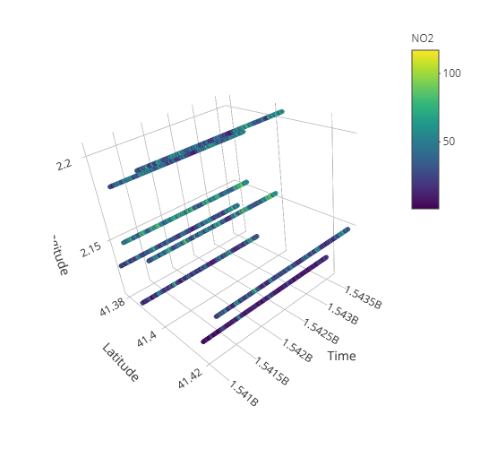

Slide 20
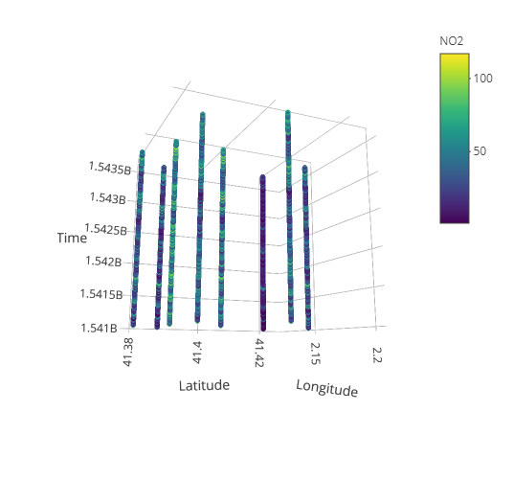

Slide 21
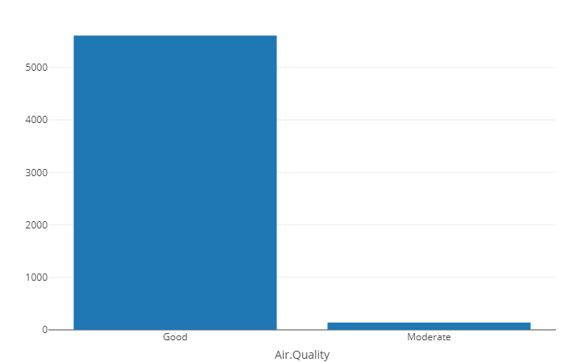
PROPORTION OF AIR QUALITY IN BARCELONA OVER A THREE MONTH PERIOD

Slide 22
CORELATION BETWEEN O3, NO2 & PM10 VALUES

Slide 23
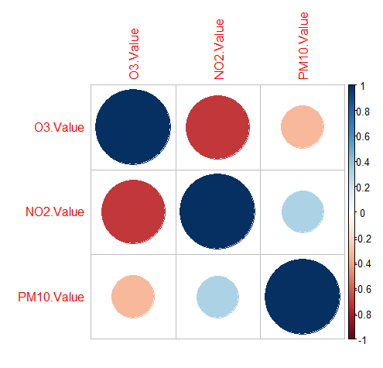

Slide 24
CLEANED DATASET:

Slide 25
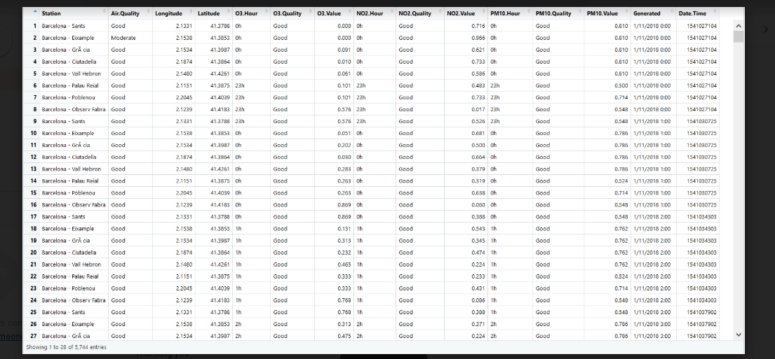

Slide 26
THANK YOU

